Slide 1


A Tsunami of Information: Exploring the Causes and Consequences of Tsunamis
February 27th, 2023
Project 3 Team 5
Data Analytics Bootcamp
https://github.com/AmirAhanchian/Tsunami-Project-3-team5.git
Contributors: Amir Ahanchian, Kevin Dai, Mary Toofani, Natasha Girdharry

Slide 2
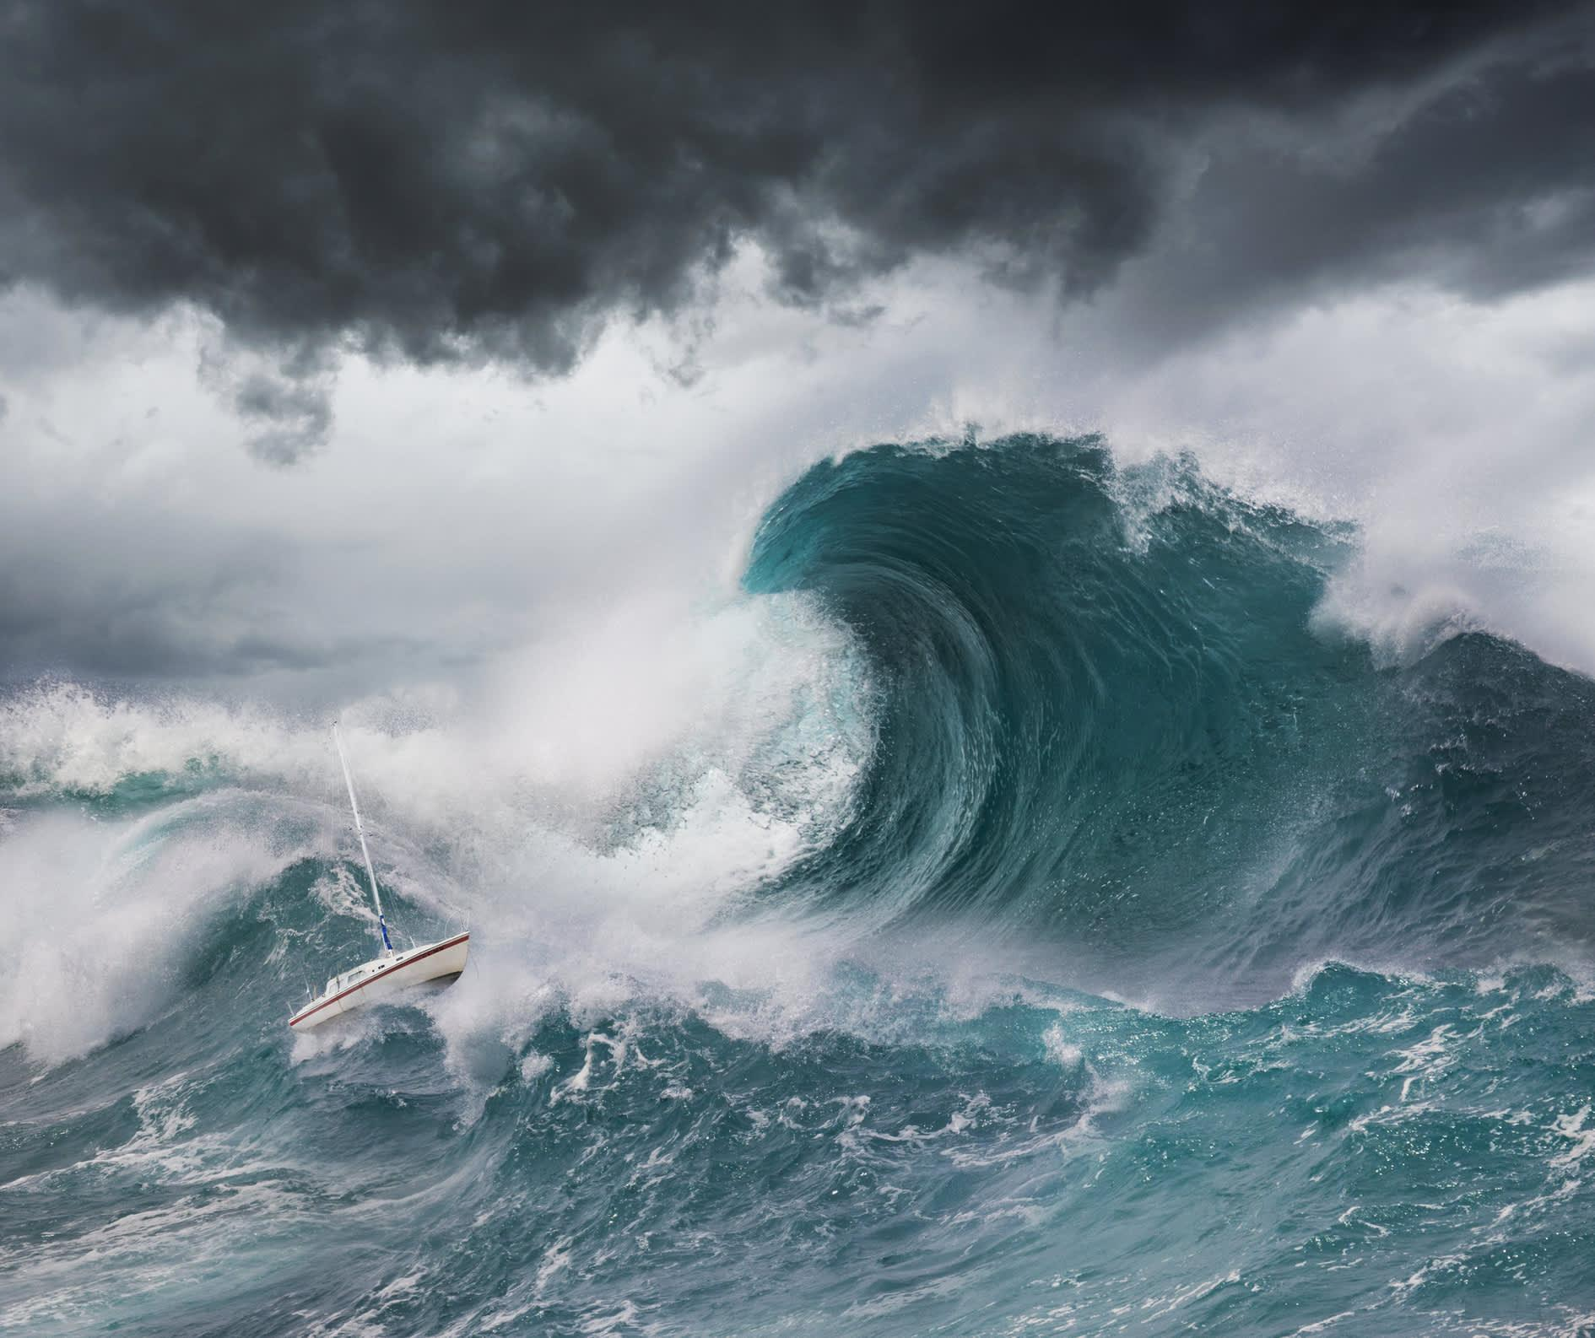
Introduction
A tsunami is a series of extremely long waves caused by a large displacement of the ocean (1).
Over 80% of tsunamis are caused by earthquakes (1) and occur in the Pacific Ocean’s “Ring of Fire" (2).
1.Derived from Tsunamis | National Oceanic and Atmospheric Administration.
2. Derived from https://www.nationalgeographic.com/environment/article/tsunamis#:~:text=Most%20tsunamis%E2%80%93about%2080%20percent,underwater%20landslides%20or%20volcanic%20eruptions.
3. Image Derived from https://www.cnbc.com/2017/11/19/tsunami-waves-detected-in-pacific-after-magnitude-7-earthquake.html
Notes:
Natasha

Slide 3
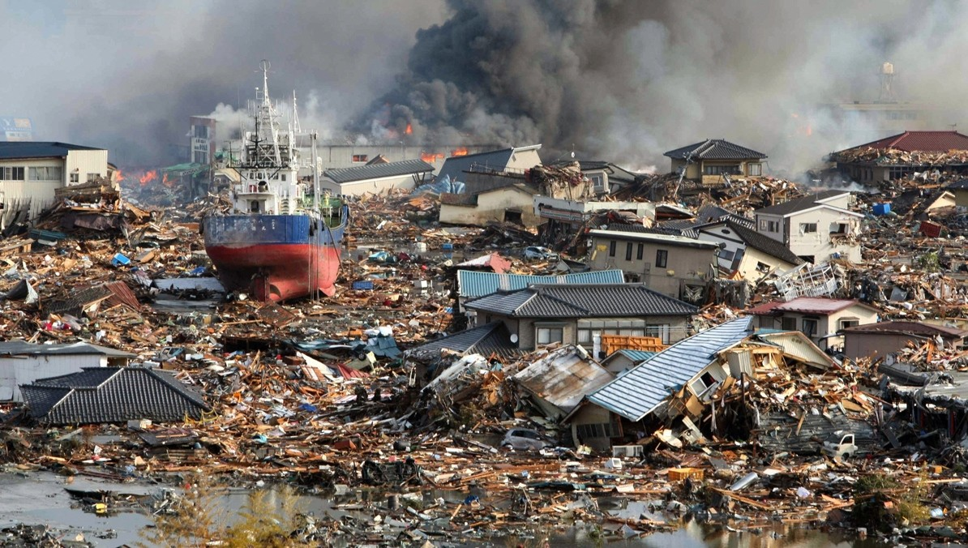
Introduction
In the deep ocean, a tsunami can move as fast as a jet plane, over 500 mph (1).
The maximum height a tsunami reaches on shore is called the “Runup”(5). When they hit land most tsunamis are less than 10 feet high, but can exceed 100 feet near their source (1).
1.Derived from Tsunamis | National Oceanic and Atmospheric Administration.
4. Image Derived from https://www.nature.com/articles/484296a
5. Derived from What Determines How Destructive a Tsunami Will Be Near the Origin and At a Distant Shore?
Notes:
Natasha

Slide 4
Research Questions
Question 1: What is the spatiotemporal pattern of tsunamis worldwide between the 1920s to early 2000s, including their frequency, geographic distribution, and main causes?
Question 2: What is the average height of tsunami waves and mortality of coastal communities?
Notes:
Natasha

Slide 5

Database Acquisition & Overview
CSV File
Source: https://www.kaggle.com/datasets/ramjasmaurya/historical-data-of-tsunamis18002021
Columns: 26
Rows: 2,163
Notes:
Kevin

Slide 6
Database Cleaning
Isolated data from 1920 to 2003
Identified data that had longitude and latitude coordinates and required information for analysis.
Original Database
Columns: 26
Rows: 2,163
Cleaned Database
Columns: 14
Rows: 285
Assumed average for null columns (earthquake magnitude, intensity, water height).
Dropped 12 columns due to unnecessary information, and nulls.
Notes:
Kevin

Slide 7

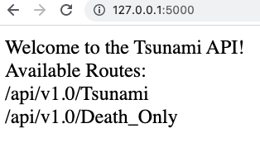
Flask Generated API
Flask Based API
Notes:
Kevin

Slide 8
Surfing the Waves of Code: Using JavaScript to Ride the Tsunami of Data
Notes:
Amir

Slide 9
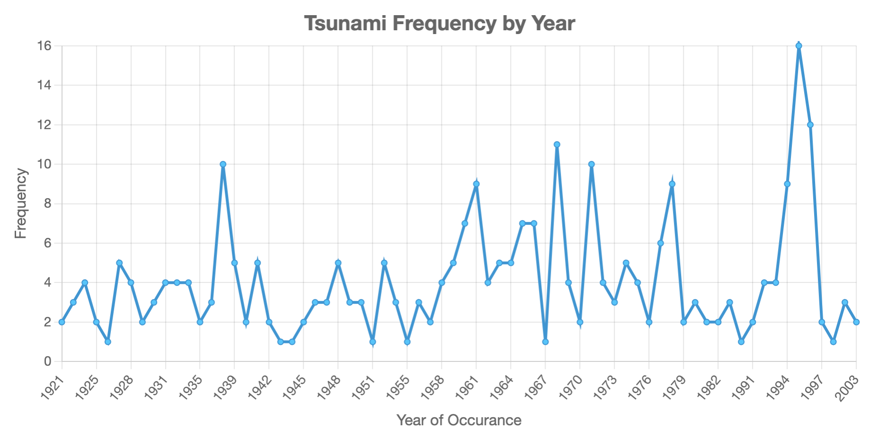
No Significant Increase in Tsunami Frequency Since 1920s
Notes:
Amir

Slide 10
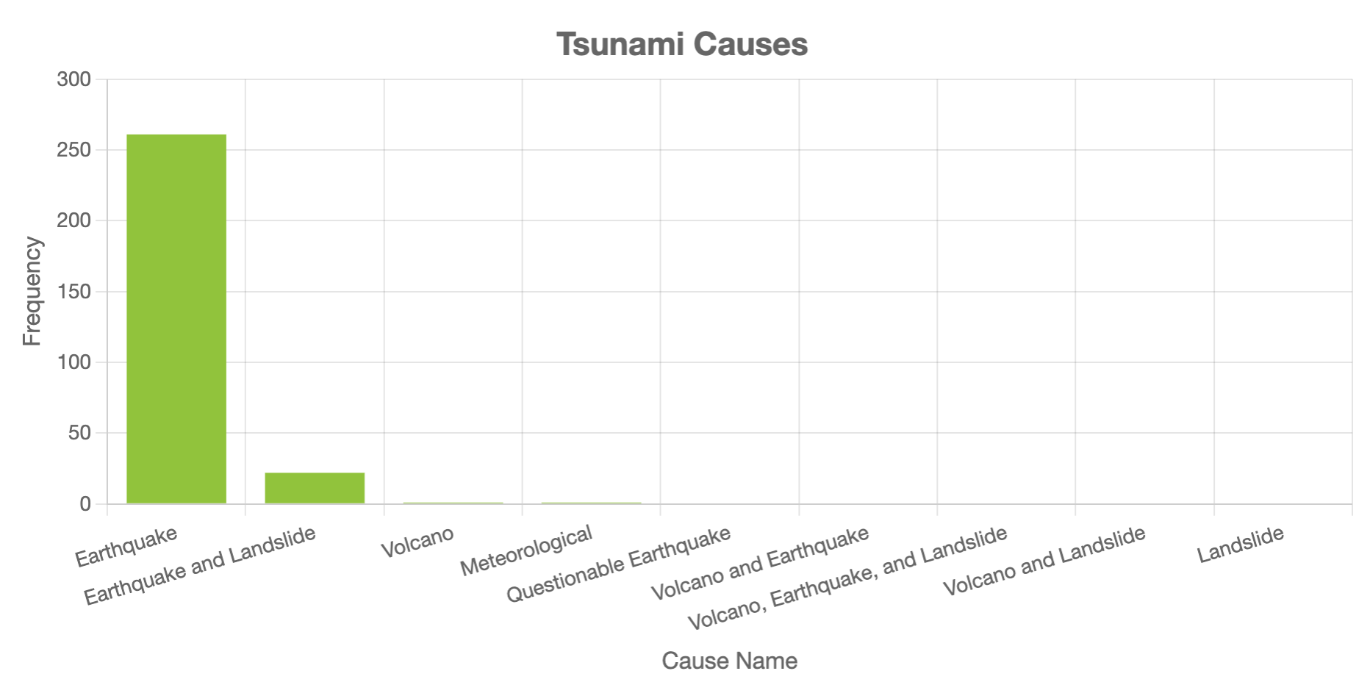
Tsunamis Main Cause: Earthquakes
Notes:
Amir ~92%

Slide 11
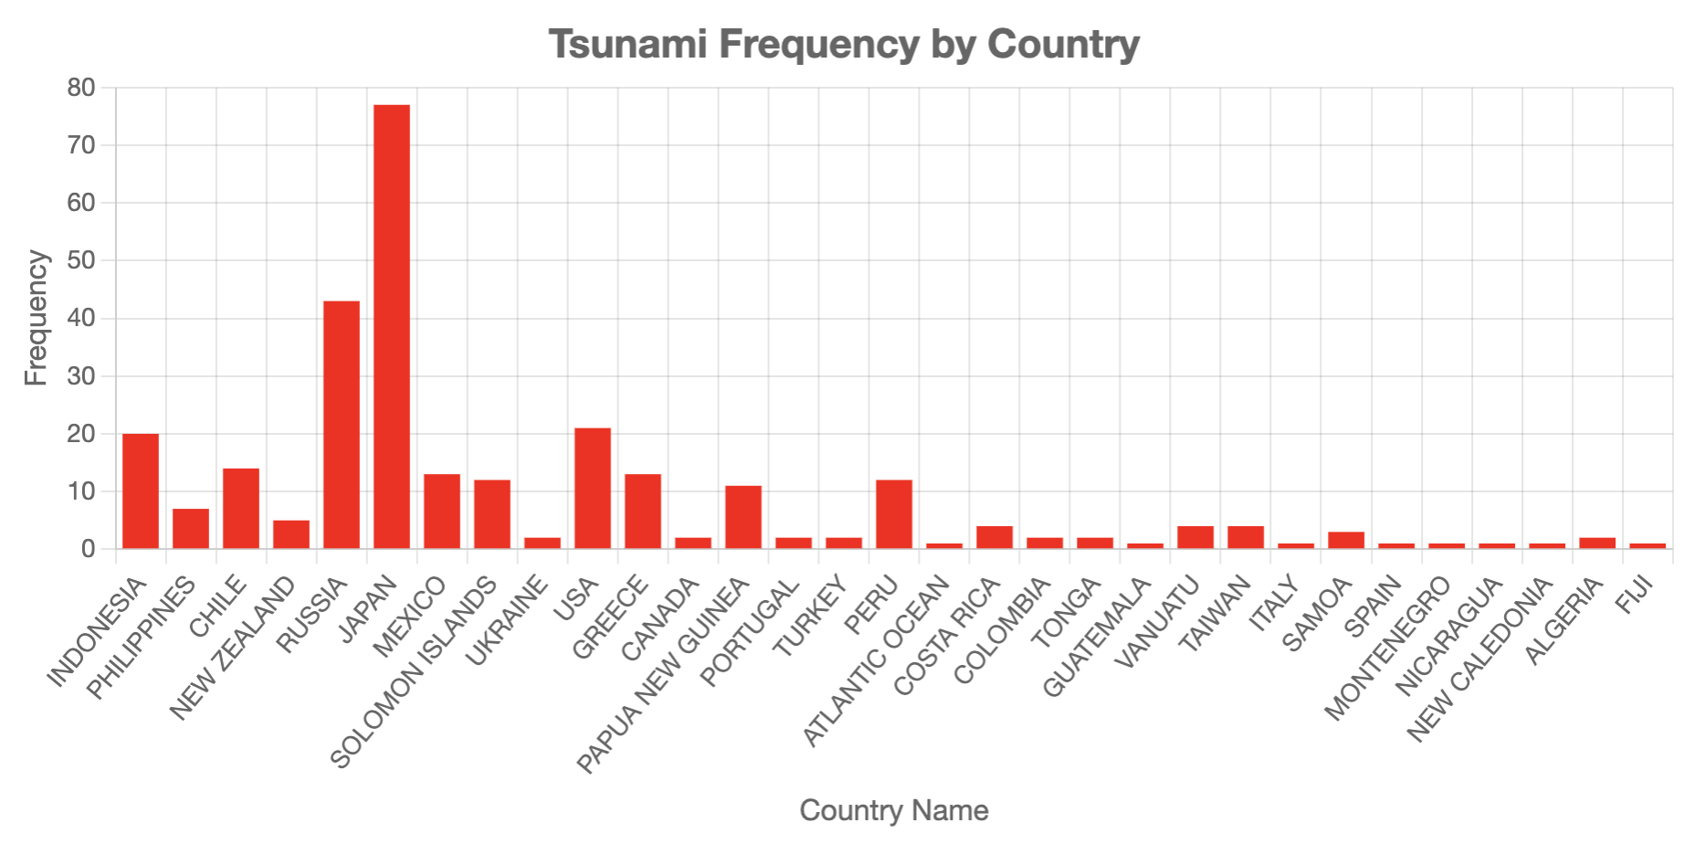
Japan: Hardest Hit by Tsunamis
Japan is located in the Pacific earthquake belt and is frequently struck by earthquakes making it vulnerable to tsunamis (6).
6. Derived from https://www.mofa.go.jp/policy/disaster/21st/2.html#:~:text=Third%2C%20Japan%20is%20located%20in,coastline%20is%20vulnerable%20to%20tsunamis.
Notes:
Amir - Japan hardest hit out of 31 countries

Slide 12
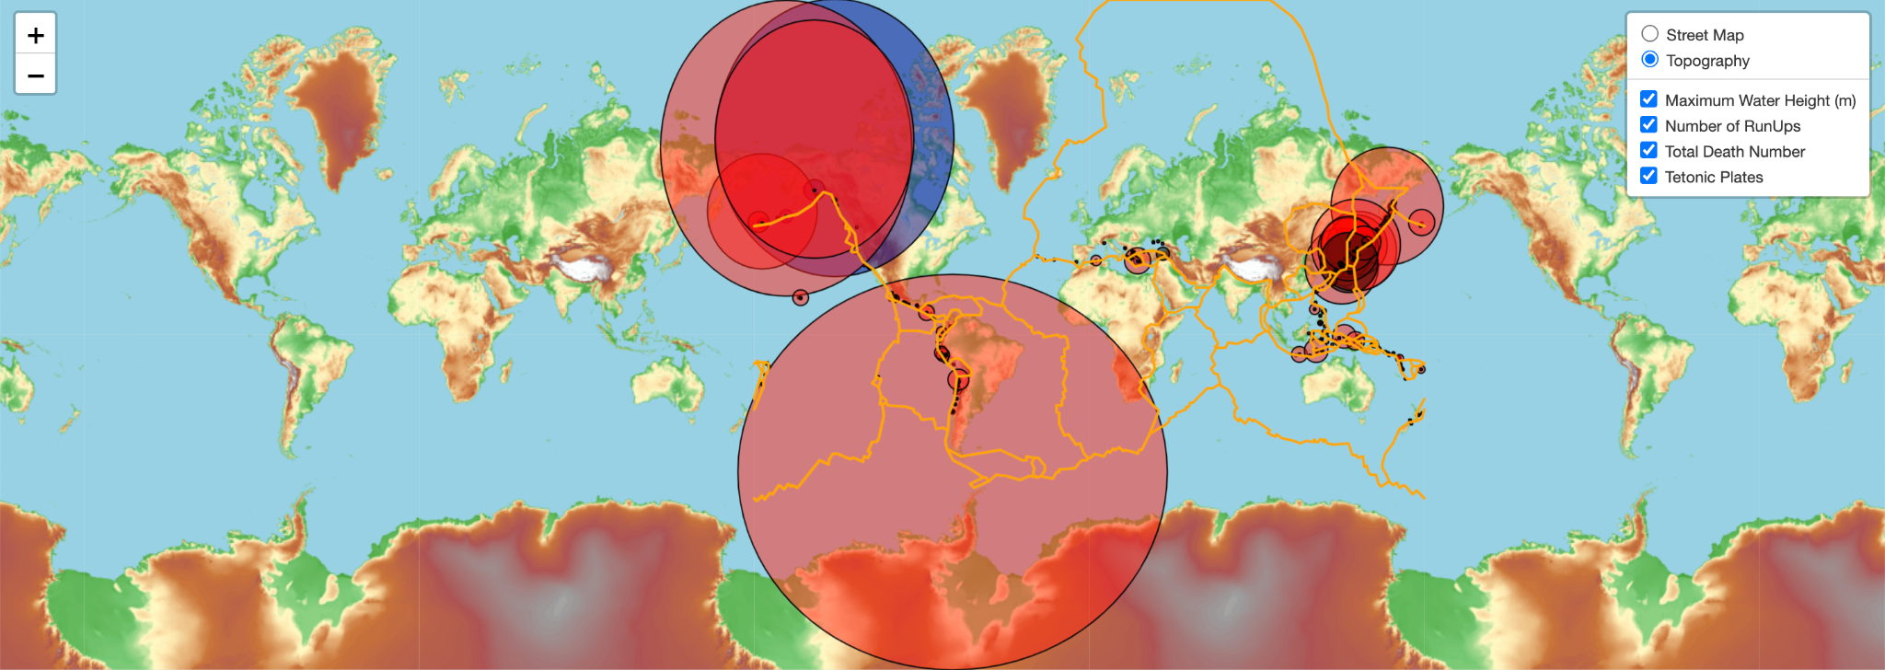
Tsunami Water Height, Run-Ups, and Fatalities Map
Notes:
Mary

Slide 13
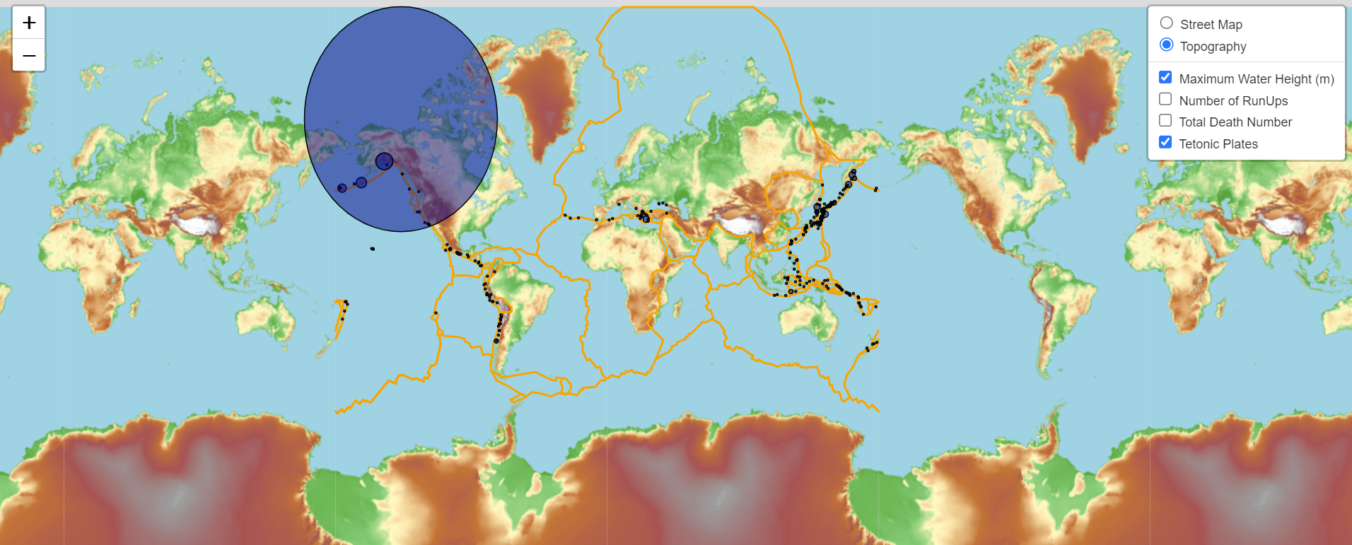
Tsunami Water Height Map

Slide 14
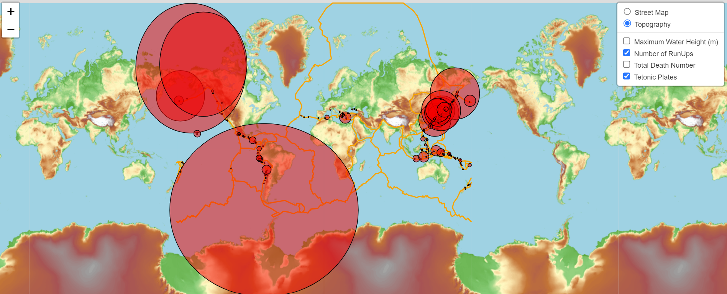
Run-Ups Maps

Slide 15
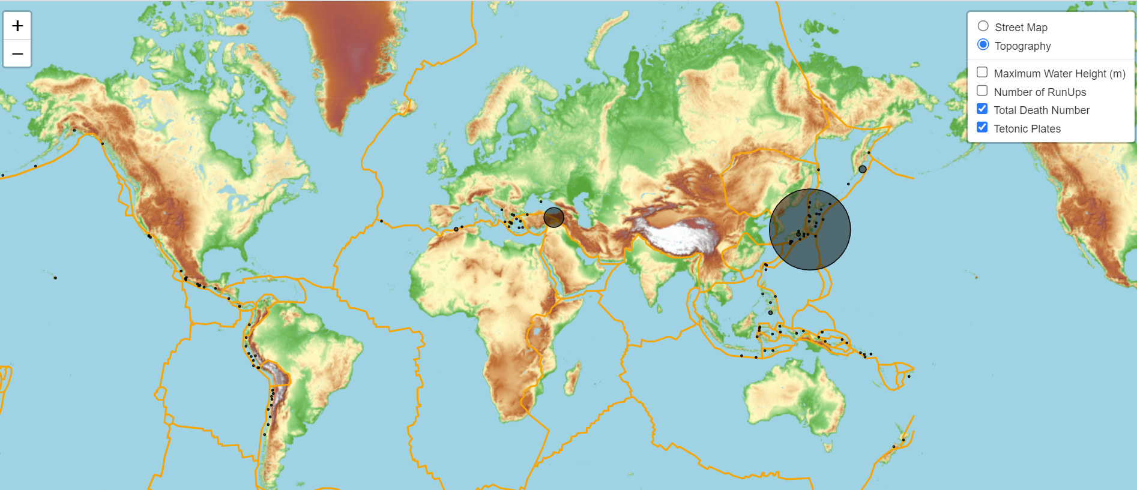
Fatalities Map

Slide 16
Limitations & Challenges
Small sample size = 285 data points
Many nulls
Assumed averages for some data points - earthquake magnitude, intensity, water height, and total deaths
Unrepresentative of Tsunami data beyond early 2000s
Notes:
Natasha

Slide 17
Conclusions & Summary
The amount of Tsunamis since the early 1920s has not significantly changed.
Majority of Tsunamis occur due to Earthquakes.
27% of tsunamis occurred in Japan.
The median deaths from a tsunami are 27 (IQR = 159) with the largest amount of deaths (142,806) occurring in Japan in 1923.
The median maximum water height of a tsunami is 0.9m (IQR = 2.8m) and the largest water height in our dataset was of 524.6 m that occurred in 1958 in Alaska.
The median run-ups are 5 m(IQR = 15m) where even a run-up of 1m is considered dangerous (5).
5. Derived from What Determines How Destructive a Tsunami Will Be Near the Origin and At a Distant Shore?
Notes:
Natasha

Slide 18
Thank you for making waves with us today!
Notes:
Natasha

